Slide 1
System Secure
Liam English x14341261

Slide 2
Introduction
Liam English
Project:
Security System with sensors
Developed on Raspberry Pi for sensors (Python)
App developed in Android Studios (Java)

Slide 3
Discussions
Advantages
Self User
Notifications
Disadvantages
Internet Usage

Slide 4
Discussion
Future Prospects
Development - available online
Very limited for a security system.

Slide 5
Goals
Problems
Linking the Raspberry Pi to the application
Running Realtime data
Solutions
Firebase

Slide 6
System
Raspberry Pi - Firebase - Android App
All sensors through a Grove Pi goes into a python fine on the Raspberry Pi
Firebase collects all the data from the python file as a String
The Android App collects the data and displays it in the application.

Slide 7
Design
Functional: Collect data from the system and display in app
Python file runs Grove Pi and collects data
Ran on the Raspberry Pi

Slide 8
Design
Functional: Log In and Out
Allow the user to Login to the system on the application
It allows the user to review data

Slide 9
Design
Functional: Create the database
Set up Firebase
Allow read and write for the database

Slide 10
Design
Functional: Review Data
To be able to see the data from the database on the application

Slide 11
Design
Functional: Notification
The user will get a notification when there is change of data.

Slide 12
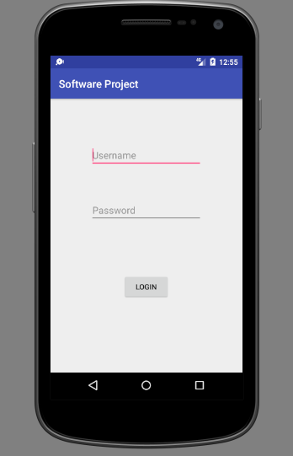
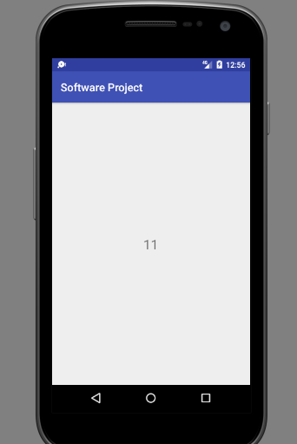

Slide 13
Evaluation
donec quis nunc
I plan on reviewing each function after each function is complete
Results:
Display Issues?
Functional Problems?

Slide 14
Going Forward
I want to be able to tackle the project better than what I have been.
I need to record the camera sensor once I get a camera
Tackle the database realtime issue

Slide 15
FEEDBACK?

